Slide 1
MSIS 5633- PREDICTIVE ANALYTICS TERM PROJECT
MOTOR VEHICLE CRASH INJURY SEVERITY ANALYSIS
Team 06 – Jayashri Jayaraman, VamsiKrishna Reddy SiddamReddy, Carson Jones, Saidabi Karumanchi

Slide 2




OUR TEAM
Siddam
Vamsi
Carson
Jones
Jayashri
Jayaraman
Saidabi
Karumanchi

Slide 3
AGENDA
OVERVIEW
BUSINESS UNDERSTANDING
DATA UNDERSTANDING
DATA PREPARATION
MODELING
TESTING AND EVALUATION
DEPLOYMENT
CONCLUSION

Slide 4
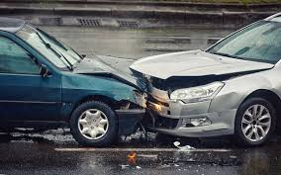
OVERVIEW
PROJECT STATEMENT: Using KNIME and crash data, we will apply the CRISP-DM methodology to identify key factors that contribute to crashes resulting in severe injuries versus those that do not. Additionally, we will develop and evaluate multiple predictive models to forecast injury severity outcomes.

Slide 5

BUSINESS UNDERSTANDING
Goal: Predict the severity of injuries in automobile crashes using machine learning techniques.
Purpose: Help policymakers, emergency services, and transport authorities make data-driven decisions for improving road safety and resource planning.
Key Questions:
What factors contribute most to major injuries?
Can we build a model to anticipate injury outcomes from crash-related data?
Success Criteria:
High predictive accuracy and reliability.
Clear interpretability of key risk factors.
Practical application for traffic safety strategy and incident response.

Slide 6
DATA UNDERSTANDING
THE RAW DATA FOR THE FOUR DATASETS USED IN THE PROJECT
Vehicle – 88 columns, 94718 rows
Accident – 46 columns, 54745 rows
Person – 57 columns, 131962 rows
Distract -11 columns, 94780 rows

Slide 7

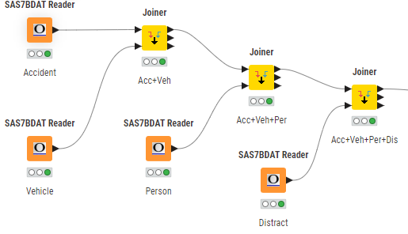
DATA UNDERSTANDING
Data was joined using KNIME using full join to merge ACCIDENT and VEHICLE data, then PERSON and DISTRAT data sets.
For this analysis, we have excluded Pedestrian and Large Truck Data and variables that are not fully independent of INJ_SEV

Slide 8
DATA PREPARATION
Missing Values
Missing values were replaced with the median or mean using missing value nodes.
Dependent Variable –INJ_SEV
The values are binned to Major and Minor to allow for binary selection in modelling

Slide 9
DATA PREPARATION
Derived Variable
The variable VEH_AGE was derived from MOD_YEAR using the math formula
2023 - $MOD_YEAR$
The variable OVERSPEED was derived from TRAV_SPD and SPD_LIM
Overspeed = TRAV_SPD – SPD_LIM

Slide 10
DATA PREPARATION
A total of 34 variables were chosen that potentially would help determine the severity of injury in an accident
Drive factors( eg. Age, Drug, Alcohol)
Environmental factors (E.g. Weather, Light Conditions )
Accident factors ( eg, Manner of Collision, Deformed)

Slide 11
DATA PREPARATION
VE_TOTAL
BODY_TYP
DAY_WEEK
URBANICITY
MAN_COLL
LGT_COND
WEATHER
VEH_AGE
REL_ROAD
GVWR_TO
ALC_RES
DRUG_RES
IMPACT1
ROLLOVER
DRDISTRACT
AGE
P_CRASH1
P_CRASH2
P_CRASH3
P_CRASH4
P_CRASH5
HARM_EV
PNUMOCCS
VSPD_LIM
AIR_BAG
REST_USE
DEFORMED
M_HARM
P_MONTH
WRK_ZONE
EJECTION
HAZ_MAT
TRAV_SP

Slide 12
DATA PREPARATION
Data Filtering
Only minimal filtering of the data was performed, to leave as much information in the set as possible
BODY_TYP was filtered, using row filter node, including values from 1-49 eliminating the other type of vehicles
MOD_YEAR was filtered to include values from 1990-2023 there by eliminating 9999 values that were entered for “unknown” in the data set
Rule Engines were using to group the data

Slide 13
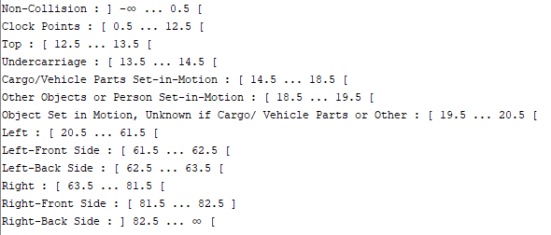
DATA PREPARATION
Binning Values
Binning is used to categorize the continuous numerical values into categorical values by separating the values into “bins”
By reducing noise in the data and making outliers easier to detect, binning enhances the accuracy of machine learning models.
DAY_WEEK
URBANICITY
REL_ROAD
GVWR_TO
DISTRACT
DEFORMED
HARM_EV
P_CRASH1
P_CRASH2
P_CRASH3
P_CRASH4
P_CRASH5
HAZ_MAT

Slide 14
DATA PREPARATION
Equal Size Sampling
In this project we used equal size sampler to under sample the categorical column (INJ_SEV) and make it equally distributed.
One To Many
The one-to- many node is used to covert nominal data to numerical data for use in models that cannot use nominal data (Logistic Regression, Neural Network)
Normalizing
The normalizer node converts all numerical data in a column to a set range(0-1). This prevents columns with large values from overpowering the columns with smaller values.

Slide 15

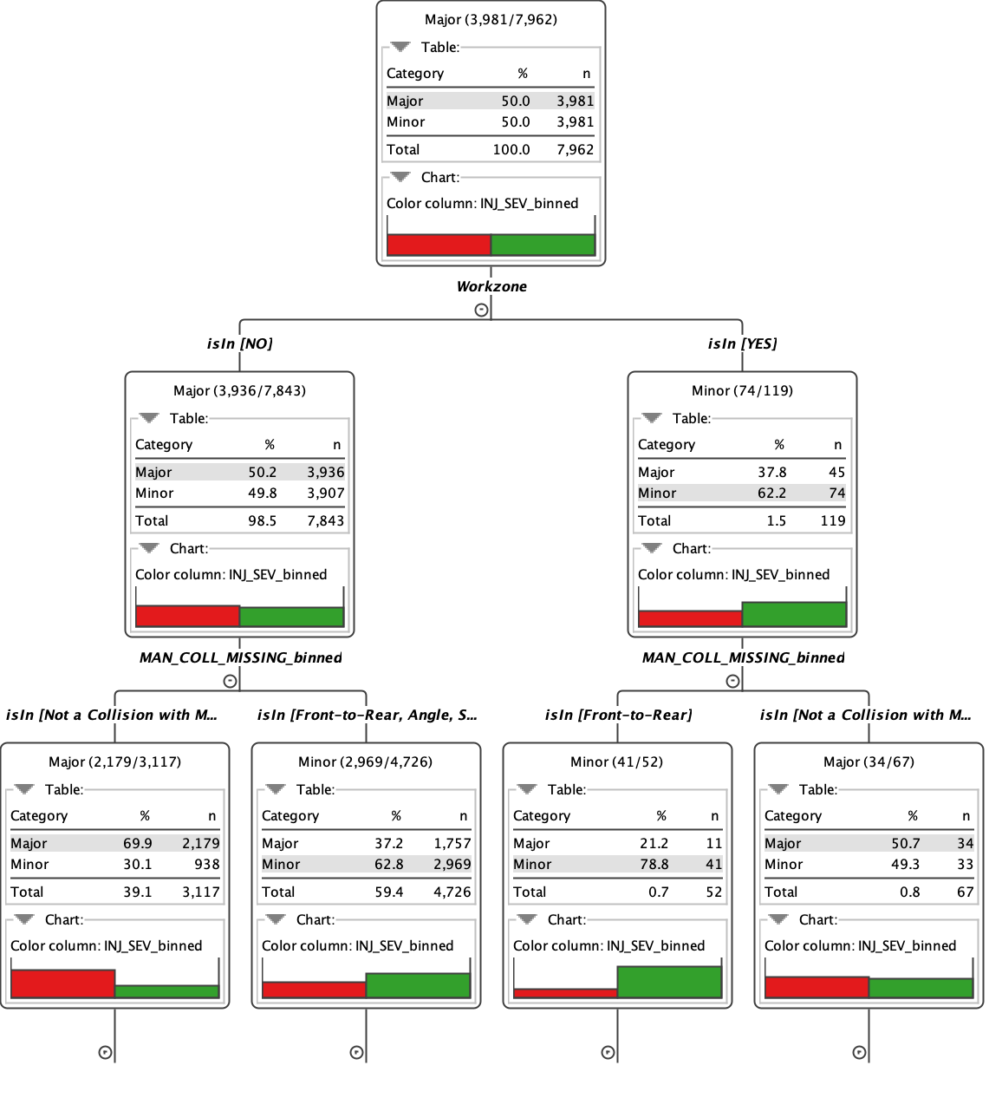

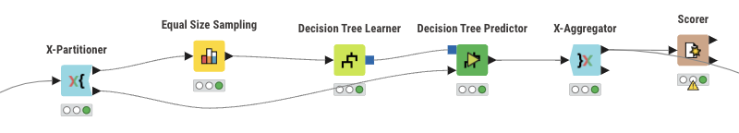
MODELING- DECISION TREE
The Decision Tree classifier uses a clear, explainable structure by splitting data at each node based on the most impactful factors.
In predicting injury severity, the model generated a hierarchical rule set that identifies which features contribute most to serious injuries.
Key variables influencing the tree's structure included seatbelt use, driver age, lighting conditions, and collision point.
Decision Trees naturally handle both numeric and categorical variables without requiring extensive preprocessing.

Slide 16
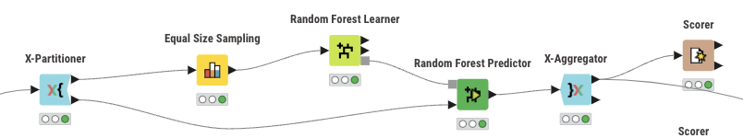
RANDOM FOREST
The Random Forest model extends Decision Trees by combining outputs from many trees trained on different subsets of the data and features.
This ensemble approach reduces model variance, leading to more stable and accurate predictions.
For the injury severity task, Random Forest improved generalization to unseen data compared to a single Decision Tree.

Slide 17
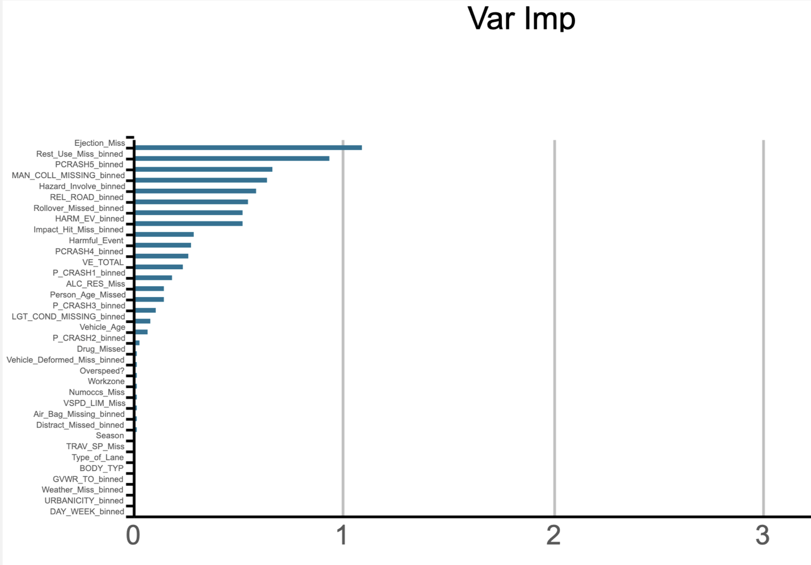
VARIABLE IMPORTANCE
Variable importance identified the features that had the greatest impact on predicting injury severity.
This analysis helped prioritize key factors influencing crash outcomes, improving model interpretability.
Important variables included seatbelt use, driver age, collision point, vehicle speed, and lighting conditions.

Slide 18
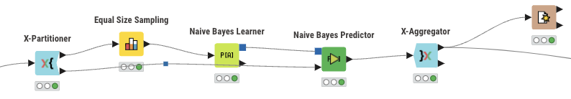
NAÏVE BAYES MODEL
Naive Bayes assumes that all attributes are conditionally independent given the target category.
This assumption limits performance, especially with complex, high-dimensional data where features are often correlated.
In our case, variables like driver distraction and ambient lighting were not independent, which could mislead the model’s predictions.

Slide 19
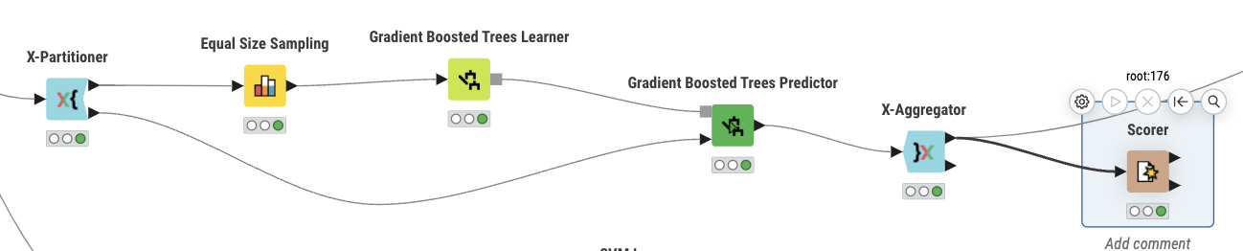
GRADIENT BOOSTED TREES
Gradient Boosted Trees (GBT) is an ensemble method that builds a strong predictor by combining multiple weak learners sequentially.
Each new tree focuses on correcting the errors made by the previous trees.
Unlike Random Forests, which average independently built trees, GBT builds trees in a sequence to minimize prediction errors step-by-step.

Slide 20
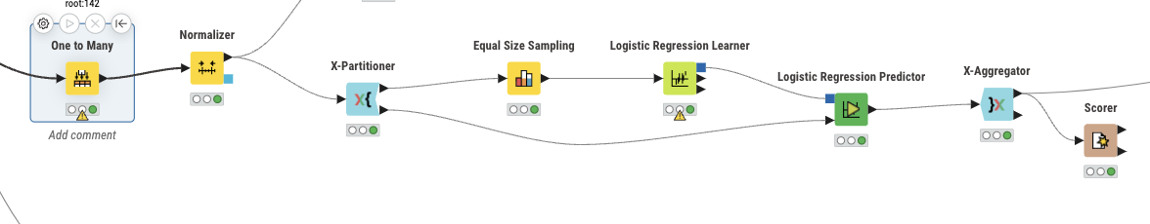
LOGISTIC REGRESSION
Logistic Regression served as a baseline model to predict probabilities for different injury severity levels.
It estimates outcome probabilities by applying a logistic function to a linear combination of predictors.
Categorical variables (e.g., seatbelt use, distraction status, illumination) were dummy encoded, while continuous variables (e.g., age, vehicle speed) were standardized.

Slide 21
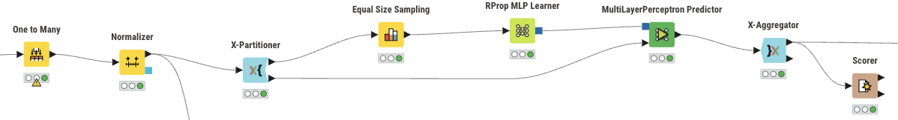
Multilayer Perceptron (MLP)
A Multilayer Perceptron (MLP) was used to detect hidden, nonlinear patterns that simpler models might miss.
A feedforward architecture with a single hidden layer was employed.
Input features were normalized using Min-Max scaling or Z-score normalization to improve convergence and model performance

Slide 22
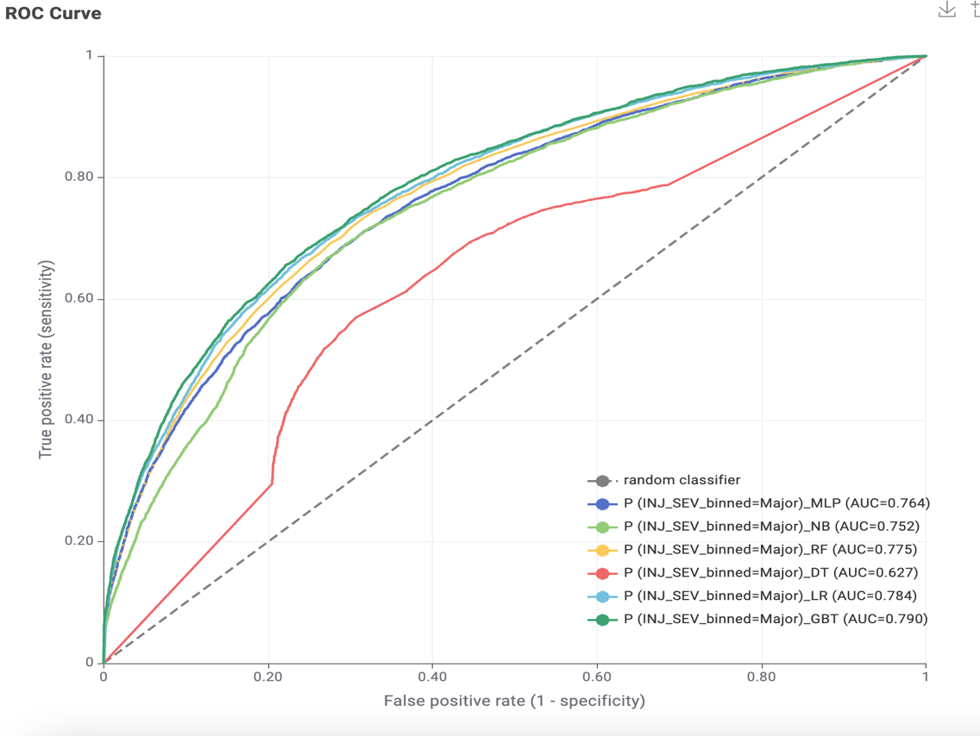
EVALUATION
Results
Results have indicated that certain factors possess a considerate likelihood of determining a high injury severity.
Model Evaluation
The graphical assessment of the effectiveness of the tests is known as the area under the ROC curve.
Observing the ROC curve results
Highest- Gradient Boosted Trees
Lowest- Decision Trees

Slide 23
EVALUATION
Model | Accuracy | Sensitivity | Specificity | ROC Curve Value (AUC)
Gradient Boosted Trees | 0.72% | Minor = 0.73% Major = 0.69% | Minor = 0.69% Major = 0.73% | 0.790
Random Forest (RF) | 0.73% | Minor = 0.76% Major = 0.65% | Minor = 0.65% Major = 0.76% | 0.775
Decision Tree (DT) | 0.62% | Minor = 0.63% Major = 0.61% | Minor = 0.61% Major = 0.63% | 0.627
Logistic Regression (LR) | 0.72% | Minor = 0.73% Major = 0.68% | Minor = 0.68% Major = 0.73% | 0.784
Naïve Bayes (NB) | 0.77% | Minor = 0.86% Major = 0.42% | Minor = 0.42% Major = 0.86% | 0.752
Multilayer Perceptron (ANN) | 0.70% | Minor = 0.71% Major = 0.67% | Minor = 0.67% Major = 0.71% | 0.764
Ranking according to accuracy
Naïve Bayes
Random Forest
Gradient Boosted Trees
Logistic Regression
ANN
Decision Tree

Slide 24

DEPLOYMENT
Key determinants of injury severity include
Ejection
Rest Use
Restraint system Used

Slide 25

DEPLOYMENT
Best Model Selected:
Gradient Boosted Trees (GBT) with AUC = 0.790.
Preparation for Deployment:
Ensure new crash data is properly integrated and formatted.
Model Application:
Predict major/minor injury severity for new accident cases using KNIME workflows.
Impact:
Supports faster emergency response and better transportation safety planning.
Future Scope:
Regularly retrain the model with updated data.
Expand to real-time injury prediction systems.

Slide 26
CONCLUSION
In Summary:
We cleaned the data through binning and rule-based processing, removing any information that could distort the analysis.
We implemented decision trees, random forests, logistic regression, naïve Bayes, multilayer perceptron, and gradient boosted trees, ultimately finding that gradient boosted trees achieved the highest ROC score of 0.790.
We believe that consistently applying these models can continue to generate valuable insights and actionable intelligence for businesses, government agencies, and consumers.

Slide 27

THANK
YOU

